Slide 1
Project 2 paper

Slide 2
How to produce paper 2
More open ended
Need to see your group produce 5 diagrams, then discuss
SWOT
BMC
Ishikawa, root causes of problems and successes in your problem domain
BMM
BPMN

Slide 3
introduction
problems | Solutions, mission
Cultural events are hard to promote | Facilitate event promotion, involve the simplicity of mobile aps
IB / FB / Tw are ok, but fail to generate traffic for most cities; social media is important, but inadequate in its metaphor | Provide a more intuitive, custom interface for club-going, better than IG
Event buyers don’t know what’s inside the event beforehand, lack criteria to make purchase decisions (keeps prices rock bottom) | Provide multiple opportunities to pictorially/visually express what happens in an event, in order to spur sales (multiple promotional images)
People depend upon events to expand and enrich their social circle | Make the app totally cater to the club scene, to involve only people motivated to be customers
The world is mobile, all promotional data circulates via mobile | Make the experience entirely mobile, facilitate all transactions over mobile

Slide 4
BMM
Talk about your goals, missions, ends, desired results, etc
Talk about strategies, tactics
Fulfill the motivation model, and discuss it

Slide 5
BPMN
Outline the behavior set needed to help drive sales, commerce

Slide 6
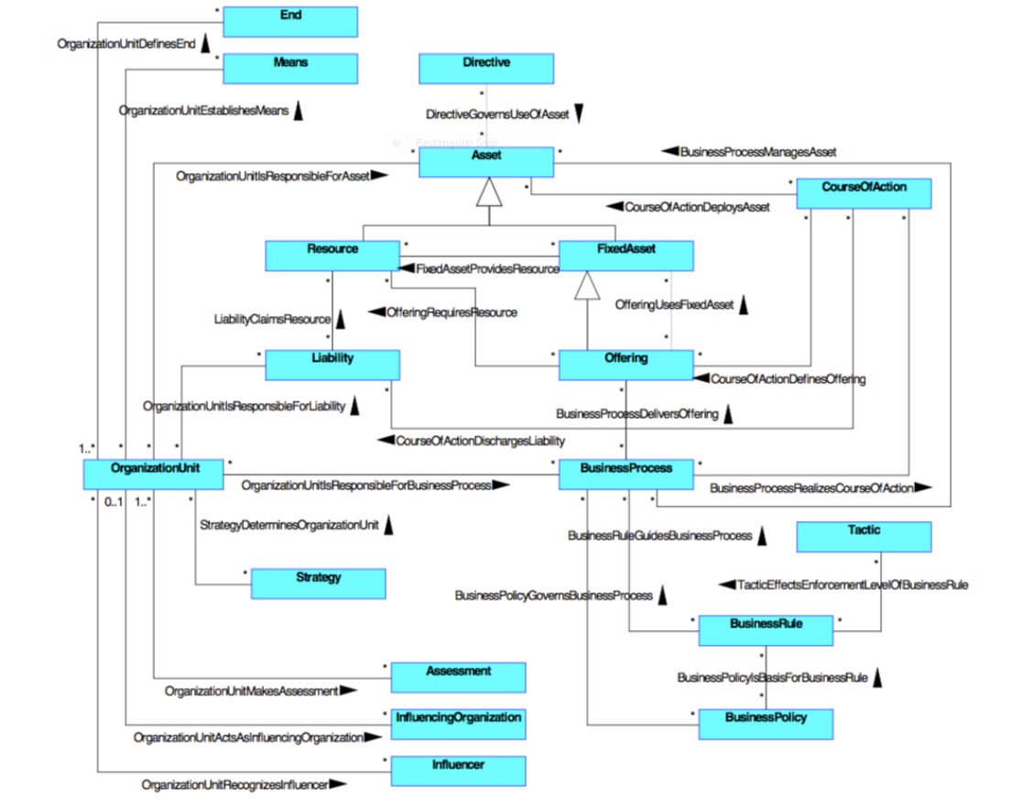
Tonight discuss this diagram in the presentation:

